Slide 1
Programming for Data Science Project Airbnb Listings - USA
Group Number 13
Likith Vinayaka Giridhar (LXG210034)
Muaaz Ali Syed (MXS220139)

Slide 2

Business context:
As an Airbnb host, when you manage multiple listings in various cities across the USA, the goal is to optimize the performance of these listings to attract more guests and achieve higher occupancy rates.
The number of reviews a listing receives is a crucial indicator of its popularity and guest satisfaction. Positive reviews can attract more potential guests and improve the overall reputation of your listings.
With data points including neighbhorhood, room_type, price, number_of_reviews, reviews_per_month as well as details on number of reviews in the past 12 months.
To achieve this, we build a machine learning model that can predict the number of reviews a listing has received in the last 12 months.

Slide 3
Let us discuss our Dataset
The target variable number_of_reviews_ltm which represents the number of reviews a host has received in the last 12 months
The Size of our dataset is 325858 records and 21 columns
The remaining variables provide additional details about the hosts, including neighbourhood_group, neighbourhood, latitude, longitude, room_type, price, minimum_nights, number_of_reviews, last_review, reviews_per_month, calculated_host_listings_count, availability_365, number_of_reviews_ltm, license, state, city and more.
Some of the variables have numerical values, while others are categorical with various levels of categories.
The dataset layout provides a tabular format with rows representing individual hosts and columns representing attributes of the hosts.
The dataset could be useful for analyzing patterns in hotel bookings and predicting future bookings, as well as identifying factors that contribute to cancellations.

Slide 4
1) Which listings have the highest/lowest number of reviews in the last 12 months?
Subset the data to include only consider mature listings which will be defined as having number_of_reviews in total >= 10
1. Mature listings with the highest number of reviews in the past year tend to be situated in popular tourist areas like Broadway Show, and they are often managed by commercial entities such as Sahara Las Vegas. These listings commonly offer 'Private room' accommodations and have shorter minimum stay requirements.
2. On the other hand, mature listings with the lowest number of reviews in the last 12 months are typically found in residential neighborhoods like Beverly Hills Apartment. They are usually hosted by individuals, like David, and predominantly offer 'Entire home/apt' rentals. Additionally, these listings have longer minimum stay requirements.

Slide 5
2) Which hosts on average have listings with the highest/lowest number of reviews in the last 12 months?
Let's only consider mature listings which will be defined as having number_of_reviews in total >= 10.On an average a guest pays around 80-120 Euros per night.
On average, hosts with mature listings that receive the highest number of reviews in the last 12 months are primarily commercial entities, like Hotel Pepper Tree. In contrast, hosts with mature listings receiving the lowest number of reviews are predominantly individuals, such as Jason.
The significant contrast in the minimum nights required between these two host types supports the observations mentioned in the first insight.

Slide 6
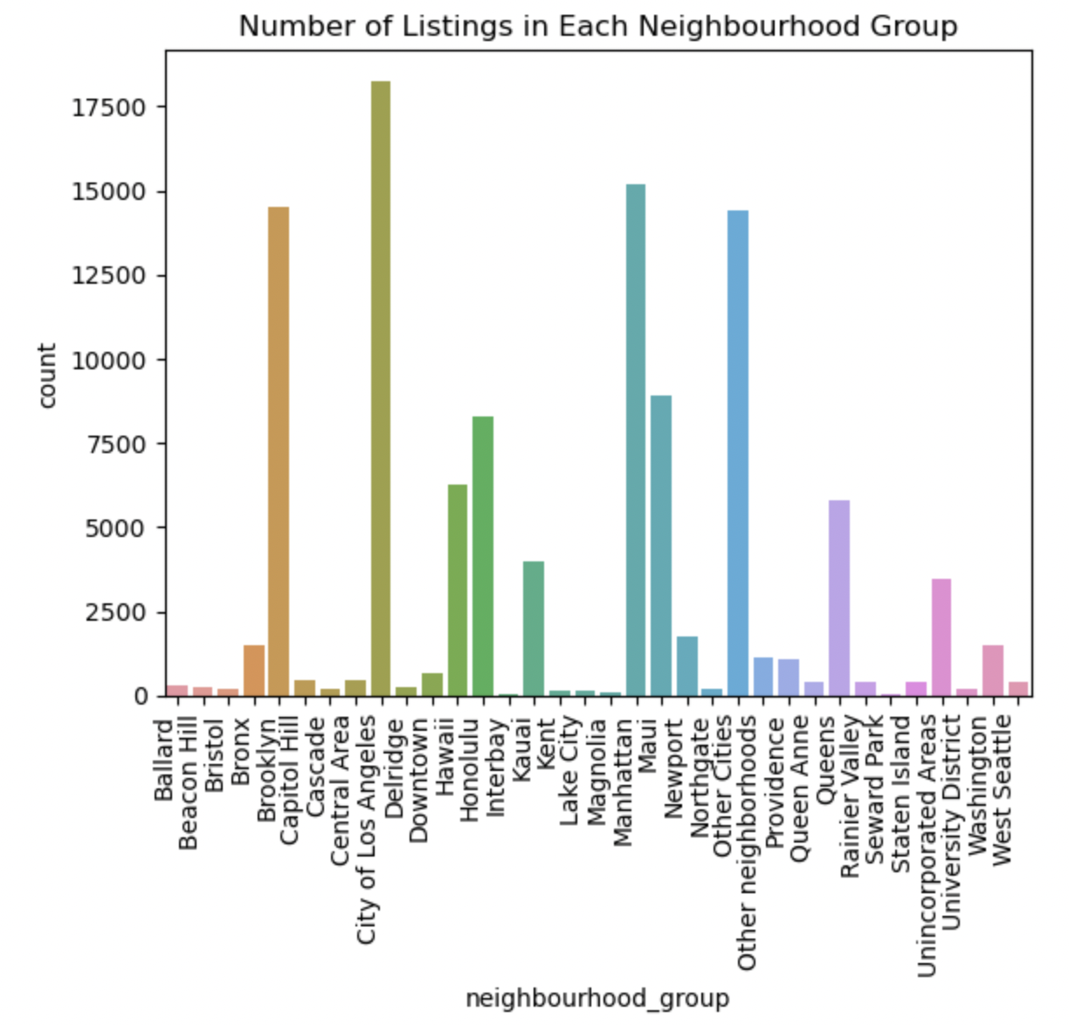
3) Relationship between Number of listings and neighbourhood group
We can see most of the listings are in the neighbhohood of major cities – Brooklyn, City of Los Angeles, Hawaii, Honolulu, Manhattan, Maui, Queens, Washington etc

Slide 7
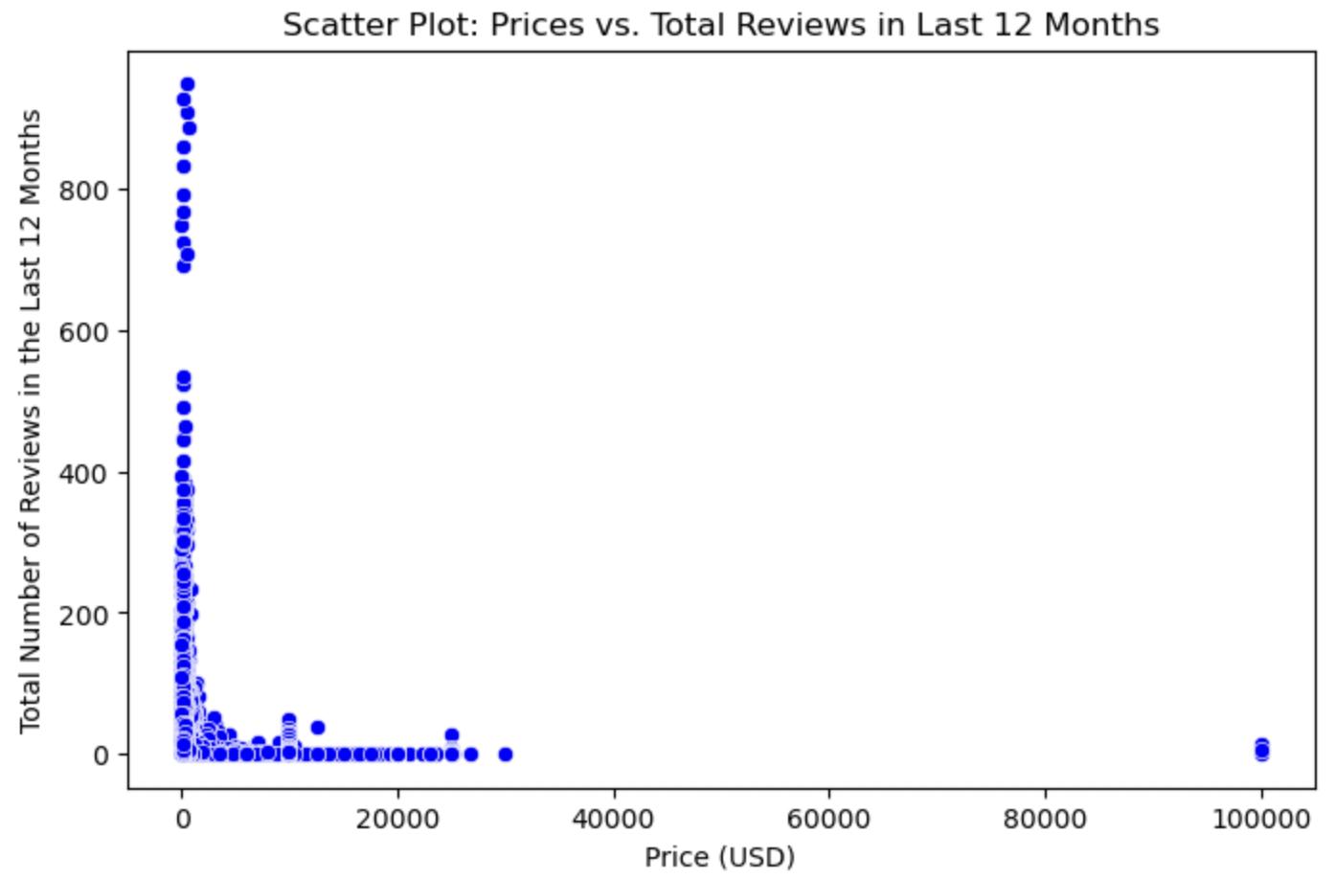
4) Does a listing's price correlate with its number of reviews in the last 12 months?
Based on the plots we can see that the listings with higher prices have lower number of reviews in the last 12 months.

Slide 8
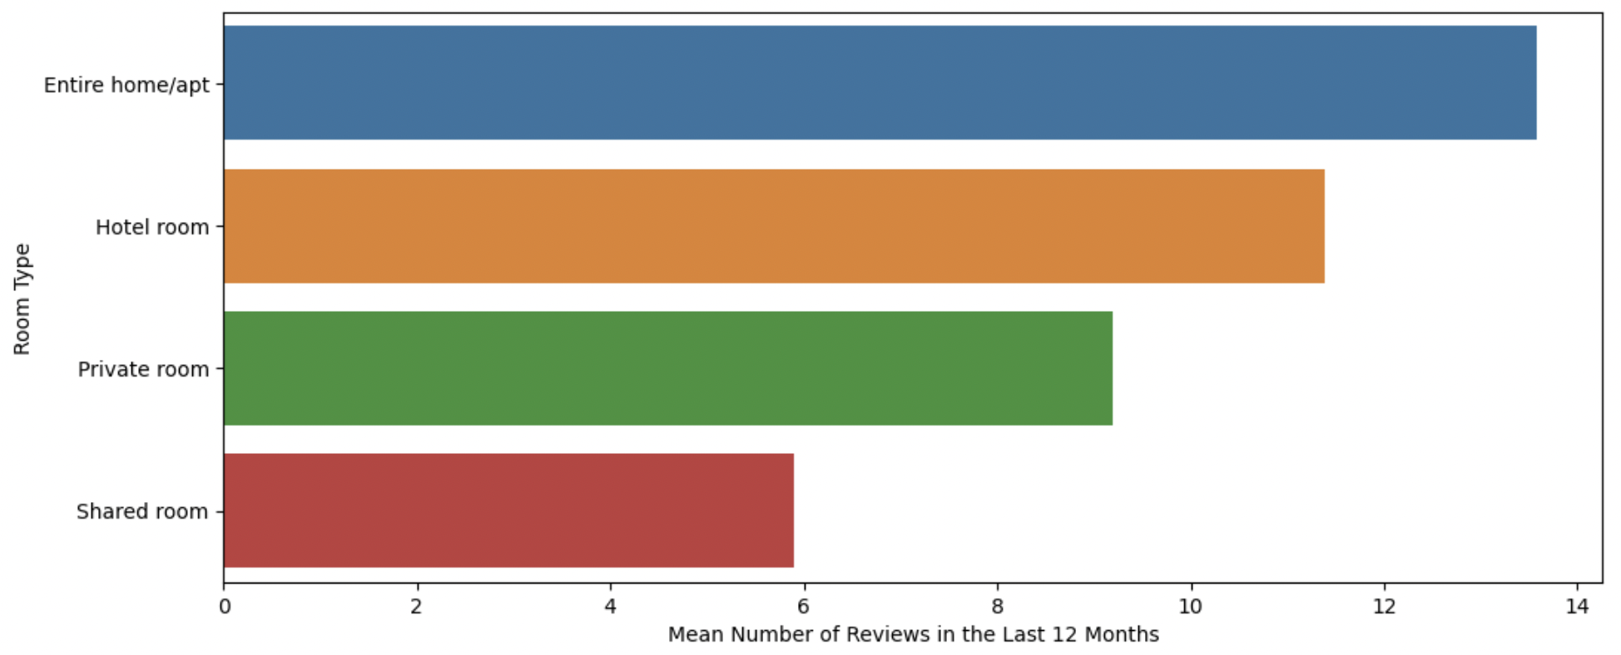
5) Which listing room types on mean have the highest/lowest number of reviews in the last 12 months?
Based on the bar chart, on median, 'Entire home/apt' room types have the highest number of reviews in the last 12 months while 'Shared room' room types have the lowest number of reviews in the last 12 months.

Slide 9
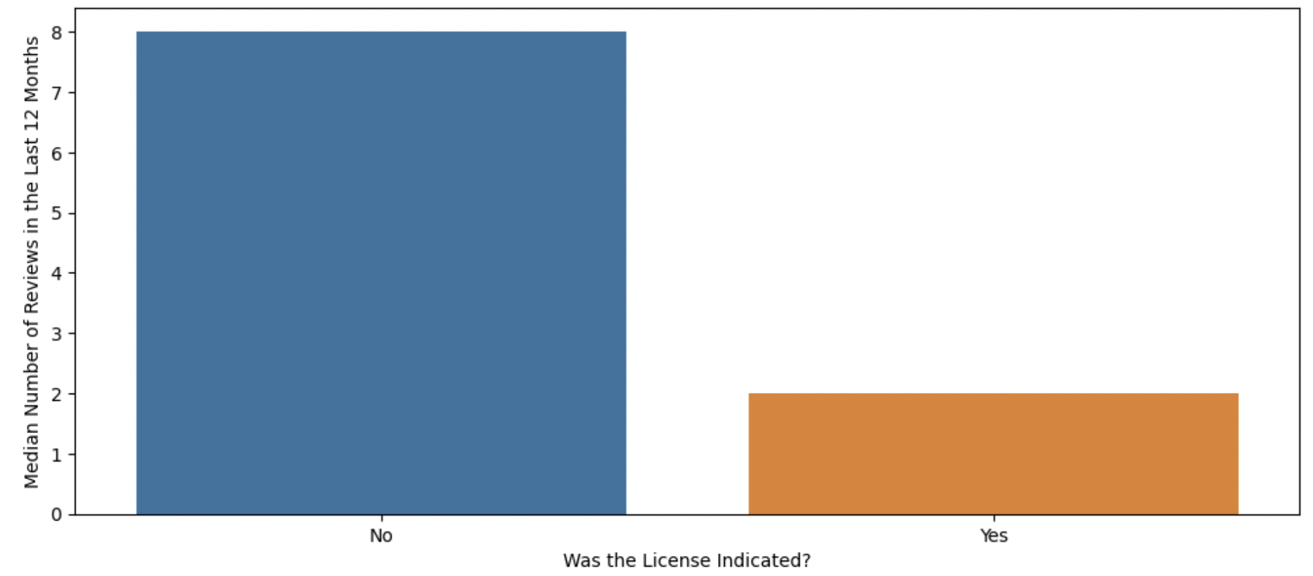
6) Do listings with indicated licenses on median differ from listings without indicated licenses in their numbers of reviews in the last 12 months?
We can notice that the listings without indicated licenses have higher number of reviews in the last 12 months than listings with indicated licenses.

Slide 10
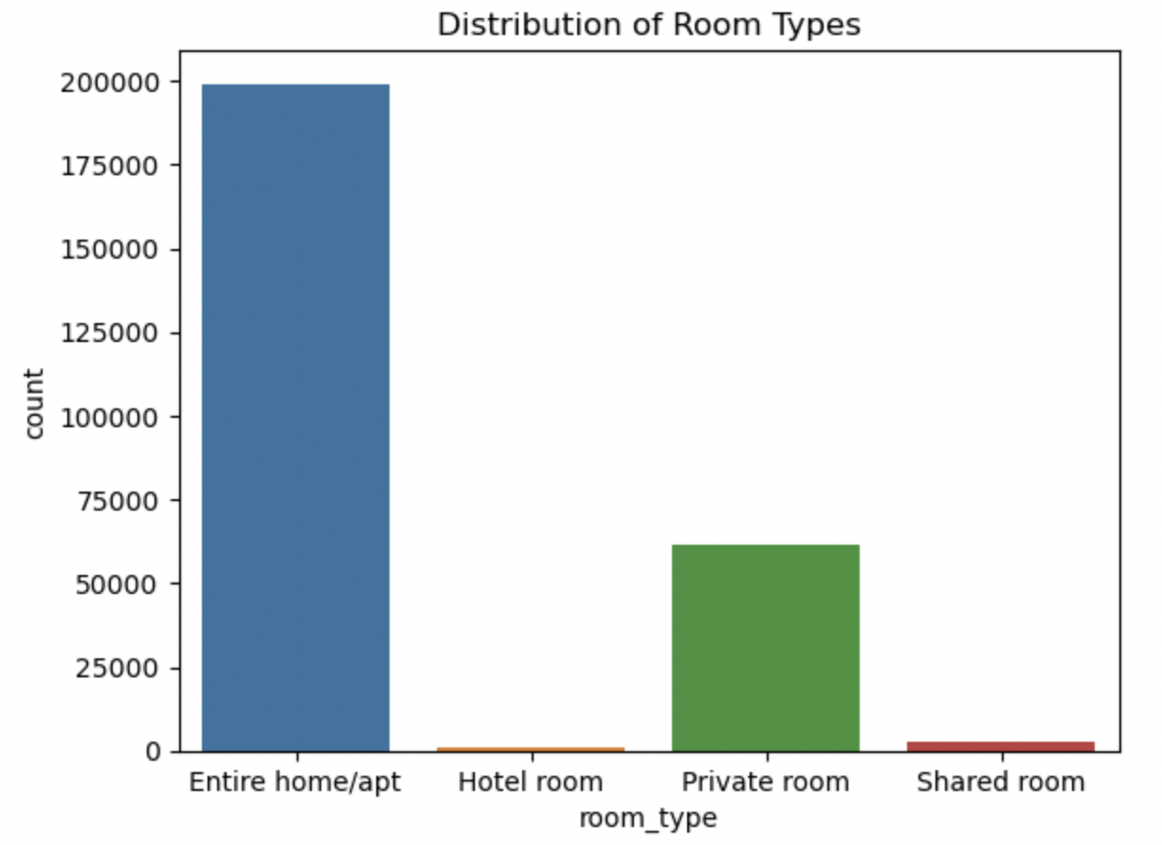
7) Distribution of room types
We can see majority of the listings are Entire homes or apartments followed by Private room meanwhile Hotel rooms and shared rooms are the least listed accommodations on Airbnb

Slide 11
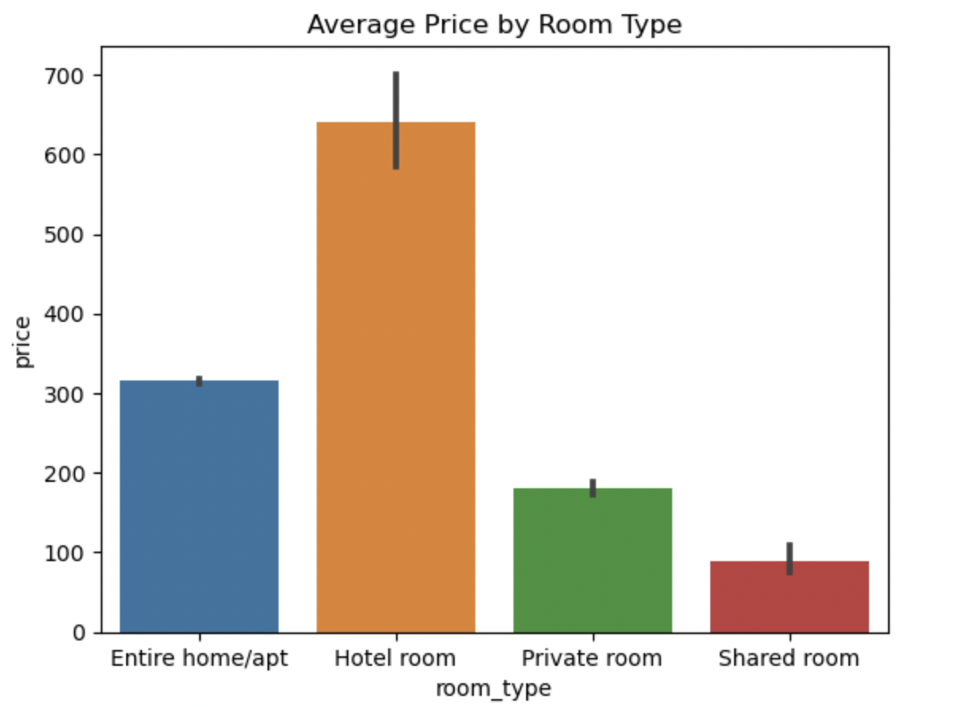
8) Average price by room type
The average price for Hotel rooms is the highest followed by Entire homes and apartments while the price is least for shared rooms

Slide 12
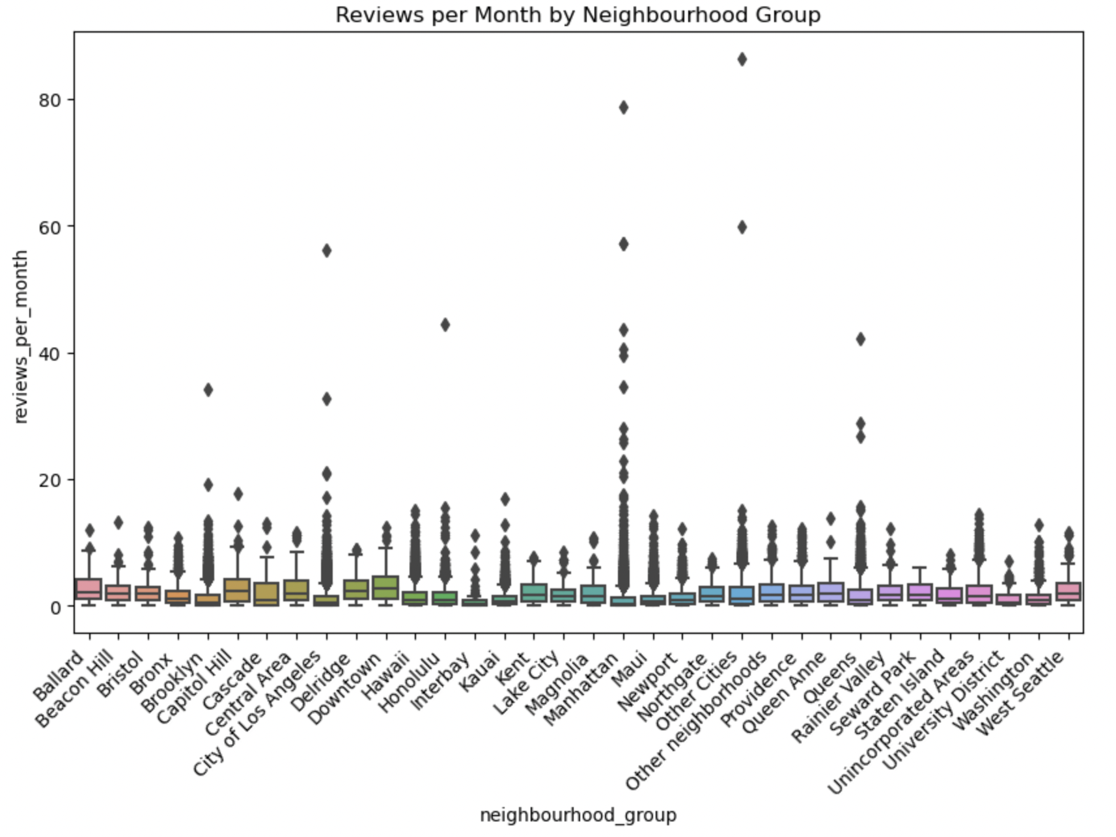
9) Reviews per month by neighbourhood group
The mean number of reviews per month remains the same for most of the neighbourhoods
But the neighbhohood of major cities – Brooklyn, City of Los Angeles, Hawaii, Honolulu, Manhattan, Maui, Queens, Washington etc have an extremely high number of outliers

Slide 13
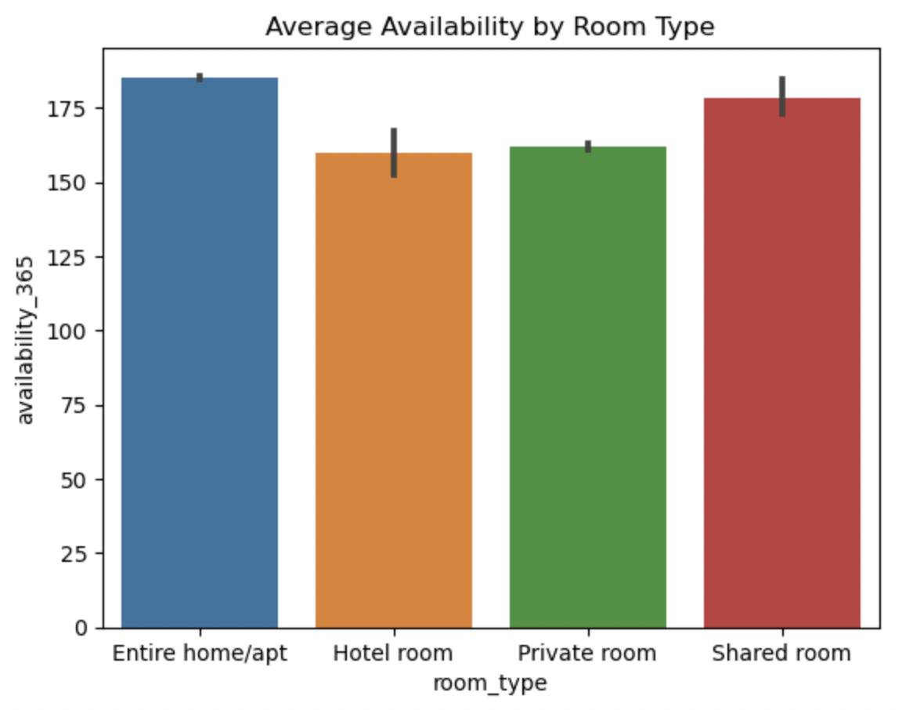
10) Average availability by room type
It is interesting to note that the average availability of all the room types 365 days in advance are the same

Slide 14
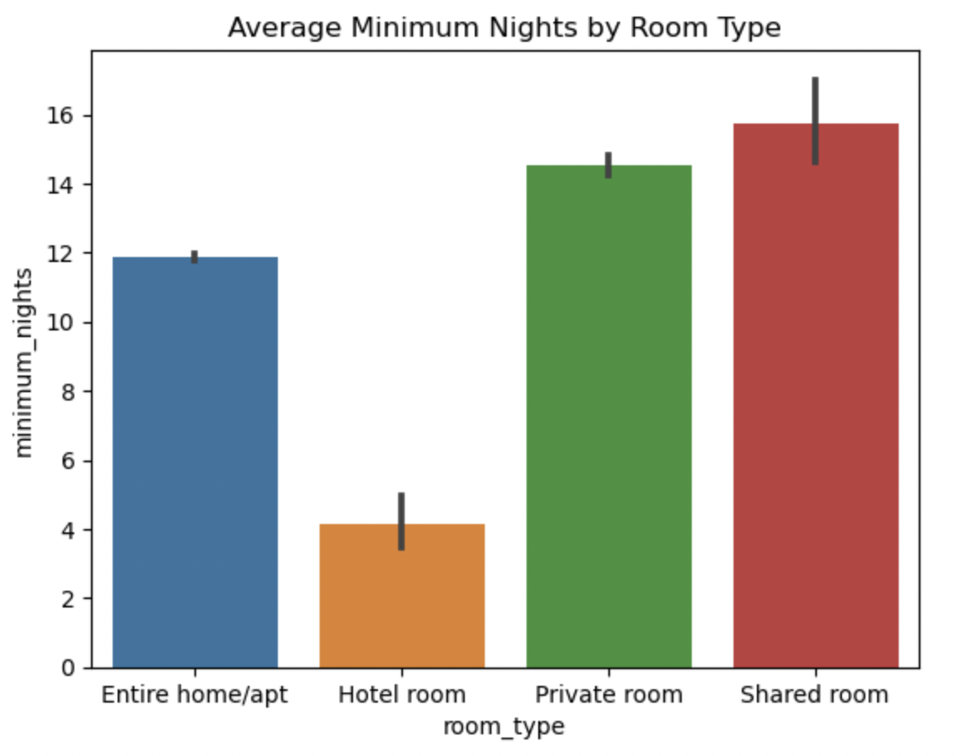
11) Average minimum nights by room type
It is interesting to note that average minimum nights by room type is highest for shared room followed by private room with hotel rooms having the lowest value

Slide 15
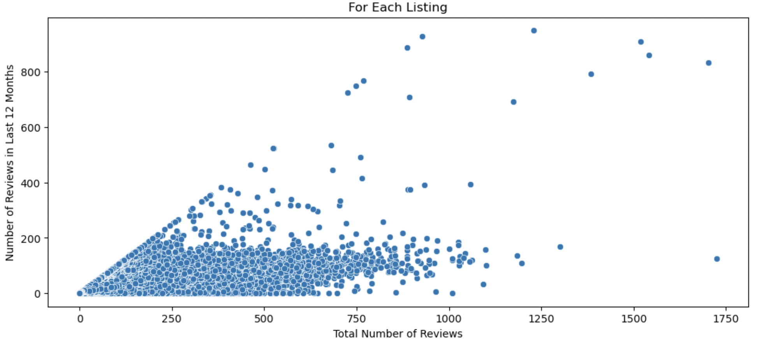
12) Relationship between two variables: "Total Number of Reviews" and "Number of Reviews in Last 12 Months"
The scatter plot helps us visualize the relationship between the total number of reviews a listing has received and the number of reviews it received in the last 12 months.
The points that are distributed in a linear or non-linear manner, it may suggest a correlation or relationship between the two variables.
The points are concentrated around a certain region, it may indicate a common behavior among listings in terms of review patterns.

Slide 16
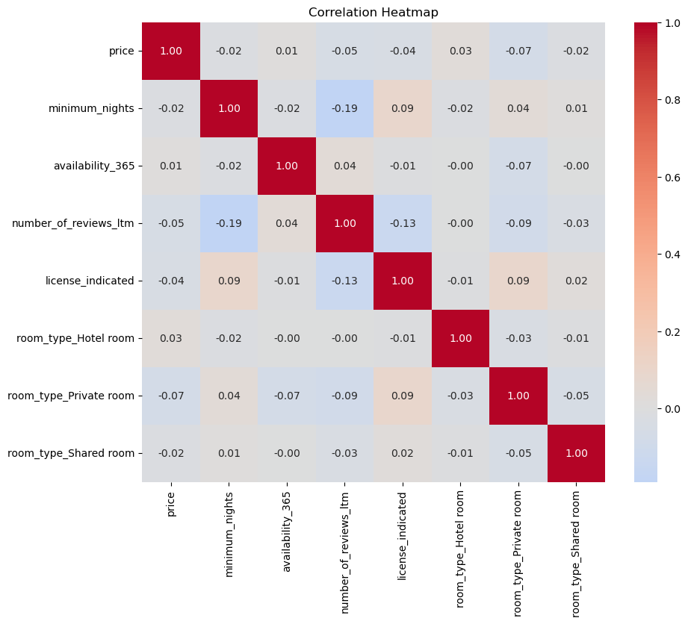
13) Heatmap Plot of the Correlation Matrix
No two attributes have high correlation as observed from the heatmap

Slide 17
Regression Model Performances
Model: Random Forest Regressor
R2_95CI_Lower: 0.1039
R2_95CI_Upper: 0.1225
Mean Squared Error (MSE): 354.4606
Mean Absolute Error (MAE): 10.8191
Model: K Neighbours Regressor
R2_95CI_Lower: 0.0892
R2_95CI_Upper: 0.1252
Mean Squared Error (MSE): 350.9676
Mean Absolute Error (MAE): 11.1235
Model: Ridge Regression
R2_95CI_Lower: 0.0507
R2_95CI_Upper: 0.0648
Mean Squared Error (MSE): 367.8673
Mean Absolute Error (MAE): 13.0653
Model: Linear Regression
R2_95CI_Lower: 0.0507
R2_95CI_Upper: 0.0649
Mean Squared Error (MSE): 367.8673
Mean Absolute Error (MAE): 13.0653
Model: Lasso Regression
R2_95CI_Lower: 0.0316
R2_95CI_Upper: 0.0417
Mean Squared Error (MSE): 377.6506
Mean Absolute Error (MAE): 13.4398

Slide 18
Hyperparameter Tuning using GridSearchCV
Model: Random Forest Regressor
Best Parameters: {'max_depth': 10, 'min_samples_split': 10, 'n_estimators': 200}
Best R2 Score: 0.24156757224429987
Model: K Neighbours Regressor
Best Parameters: {'n_neighbors': 9, 'weights': 'uniform’}
Best R2 Score: 0.16146390577720177
Model: Ridge Regression
Best Parameters: {'alpha': 10}
Best R2 Score: 0.05777755538711497
Model: Linear Regression
Best Parameters: {}
Best R2 Score: 0.05777703678941008
Model: Lasso Regression
Best Parameters: {'alpha': 0.1}
Best R2 Score: 0.05654805693174181

Slide 19
Conclusion
Based on the performance metrics and R2 values, the two most suitable models appear to be the Random Forest Regressor and the K Neighbors Regressor. These models have the highest R2 values, indicating better overall fit to the data. Moreover, they both exhibit lower MSE and MAE values, which suggest better predictive accuracy compared to the other regression models.
Between these two models, the Random Forest Regressor has slightly better performance metrics (lower MSE and MAE) compared to the K Neighbors Regressor. Therefore, the Random Forest Regressor might be the preferred choice among the tested models for predicting the number of reviews in the last 12 months in the given dataset.
The above selection of Random Forest Regressor has further been solidified by concurrence from hyperparameter tuning using GridSearchCV.
Scope for Future Work
We have done Hyper Parameter Tuning using GridSearchCV and next to improve model performance we can try RandomizedSearchCV
Try to extrapolate this model to predict the reviews for the next 12 months
Try converting the problem to a classification problem and compare the performance of classification models to the Regression models

